Slide 1
Welcome to Eden
WOULD YOU LIKE TO KNOW MORE?

Slide 2

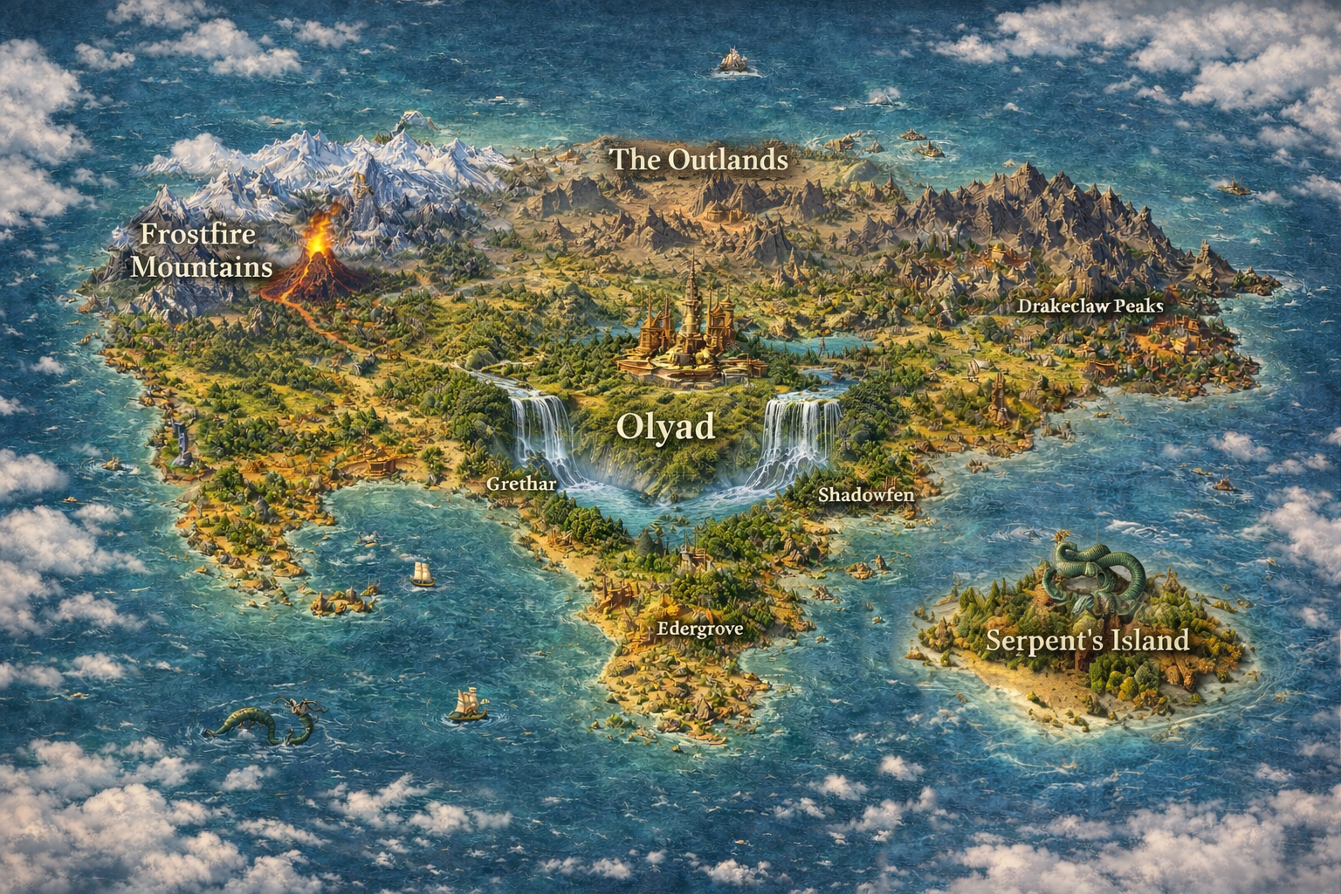
Welcome to Eden

Slide 3
Welcome to Eden
Olyad
Crown jewel and capital of Eden, Olyad is the city you call home. This city stood through siege after siege during the War of Unification, and has advanced beyond measure since the Great Peace settled over the land.

Slide 4
Welcome to Eden
Frostfire Mountains
Previously the home of the mighty Dwarfs, the Frostfire Mountains are home to the Remnants: a sect of dwarfs that did not relocate to Olyad after the destruction of their sacred mountain. Recent decades have seen the return of nature’s splendor in the surrounding area.
Olyad
Crown jewel and capital of Eden, Olyad is the city you call home. This city stood through siege after siege during the War of Unification, and has advanced beyond measure since the Great Peace settled over the land.
Serpent’s Island
Originally a penal colony for the four nations, this island became a haven for followers of The Adversary during the War of Purification five centuries ago. Although it’s thought to be a kingdom of darkness, it holds vast amounts of religious diversity that were all driven from the mainland when they refused to convert to the OTG.
The Outlands
What remains of the once proud kingdom of Mistvale, this area is now only inhabited by the Outlanders: Refugees from the War of Unifcation that refused to bend the knee. Their mission is to topple Olyad and the Regime at all costs.

Slide 5
Welcome to Eden
Frostfire Mountains
Previously the home of the mighty Dwarfs, the Frostfire Mountains are home to the Remnants: a sect of dwarfs that did not relocate to Olyad after the destruction of their sacred mountain. Recent decades have seen the return of nature’s splendor in the surrounding area.
Olyad
Crown jewel and capital of Eden, Olyad is the city you call home. This city stood through siege after siege during the War of Unification, and has advanced beyond measure since the Great Peace settled over the land.

Slide 6
Welcome to Eden
Frostfire Mountains
Previously the home of the mighty Dwarfs, the Frostfire Mountains are home to the Remnants: a sect of dwarfs that did not relocate to Olyad after the destruction of their sacred mountain. Recent decades have seen the return of nature’s splendor in the surrounding area.
Olyad
Crown jewel and capital of Eden, Olyad is the city you call home. This city stood through siege after siege during the War of Unification, and has advanced beyond measure since the Great Peace settled over Eden.

Slide 7
Welcome to Eden
The Outlands
What remains of the once proud kingdom of Mistvale, this area is now only inhabited by the Outlanders: Refugees from the War of Unifcation that refused to bend the knee. Their mission is to topple Olyad and the Regime at all costs.
Frostfire Mountains
Previously the home of the mighty Dwarfs, the Frostfire Mountains are home to the Remnants: a sect of dwarfs that did not relocate to Olyad after the destruction of their sacred mountain. Recent decades have seen the return of nature’s splendor in the surrounding area.
Serpent’s Island
Originally a penal colony for the four nations, this island became a haven for followers of The Adversary during the War of Purification five centuries ago. Although it’s thought to be a kingdom of darkness, it holds vast amounts of religious diversity that were all driven from the mainland when they refused to convert to the OTG.
Olyad
Crown jewel and capital of Eden, Olyad is the city you call home. This city stood through siege after siege during the War of Unification, and has advanced beyond measure since the Great Peace settled over Eden.

Slide 8
Welcome to Eden
Frostfire Mountains
Previously the home of the mighty Dwarfs, the Frostfire Mountains are home to the Remnants: a sect of dwarfs that did not relocate to Olyad after the destruction of their sacred mountain. They instead choose to bend the knee, but stay in their ancestral homeland despite it being a fiery wasteland. Recent decades have seen the return of nature’s splendor in the surrounding area, largely thought to be the work of druids working with the Remnants to restore nature to its previous state.
The Outlands
What remains of the once proud kingdom of Mistvale, this area is now only inhabited by the Outlanders: Refugees from the War of Unifcation that refused to bend the knee. Their mission is to topple Olyad and the Regime at all costs.
Serpent’s Island
Originally a penal colony for the four nations, this island became a haven for followers of The Adversary during the War of Purification five centuries ago. Although it’s thought to be a kingdom of darkness, it holds vast amounts of religious diversity that were all driven from the mainland when they refused to convert to the OTG.
Olyad
Crown jewel and capital of Eden, Olyad is the city you call home. This city stood through siege after siege during the War of Unification, and has advanced beyond measure since the Great Peace settled over Eden.

Slide 9
Welcome to Eden
The Outlands
What remains of the once proud kingdom of Mistvale, this area is now only inhabited by the Outlanders: Refugees from the War of Unifcation that refused to bend the knee. Their mission is to topple Olyad and the Regime at all costs.
Frostfire Mountains
Previously the home of the mighty Dwarfs, the Frostfire Mountains are home to the Remnants: a sect of dwarfs that did not relocate to Olyad after the destruction of their sacred mountain. They instead choose to bend the knee, but stay in their ancestral homeland despite it being a fiery wasteland. Recent decades have seen the return of nature’s splendor in the surrounding area, largely thought to be the work of druids working with the Remnants to restore nature to its previous state.
Serpent’s Island
Originally a penal colony for the four nations, this island became a haven for followers of The Adversary during the War of Purification five centuries ago. Although it’s thought to be a kingdom of darkness, it holds vast amounts of religious diversity that were all driven from the mainland when they refused to convert to the OTG.
Olyad
Crown jewel and capital of Eden, Olyad is the city you call home. This city stood through siege after siege during the War of Unification, and has advanced beyond measure since the Great Peace settled over Eden.

Slide 10
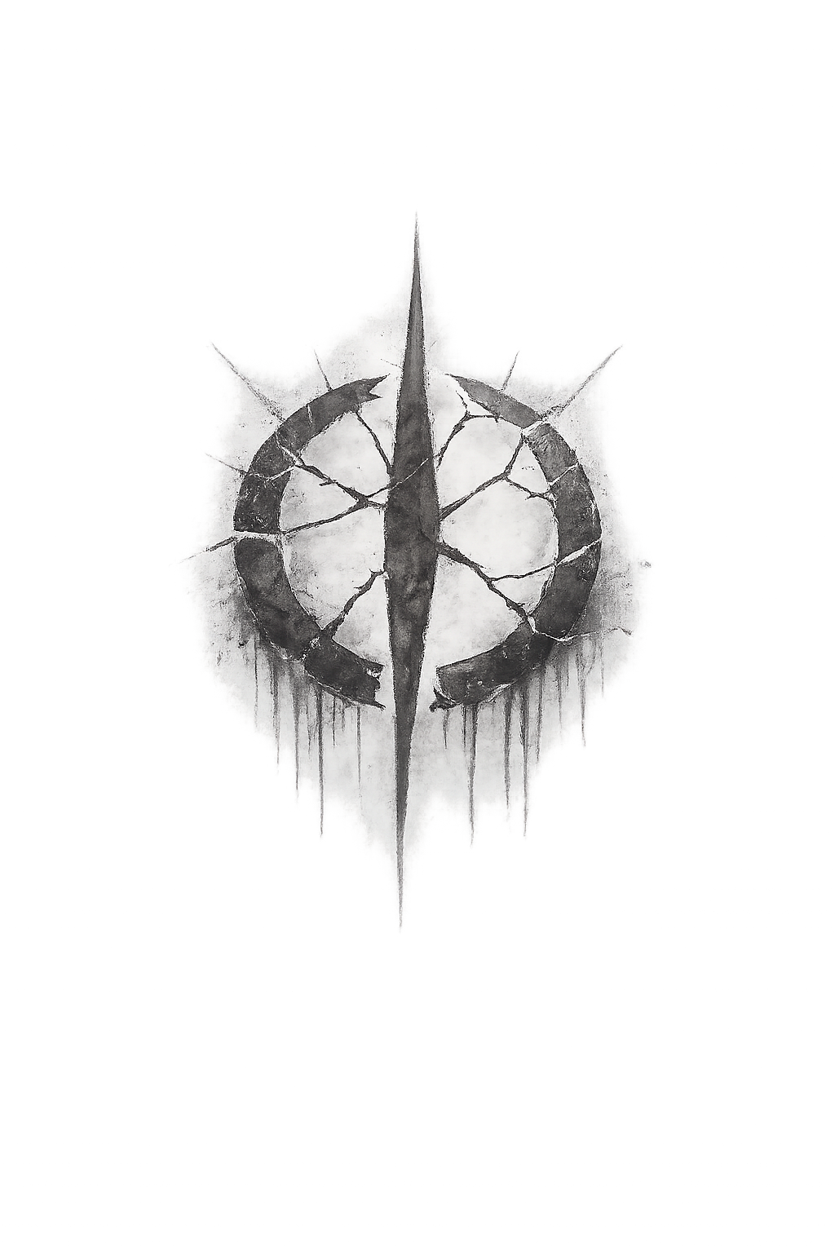
Welcome to Eden
The Outlands
What remains of the once proud kingdom of Mistvale, this area is now only inhabited by the Outlanders: Refugees from the War of Unifcation that refused to bend the knee. Their mission is to topple Olyad and the Regime at all costs.
Frostfire Mountains
Previously the home of the mighty Dwarfs, the Frostfire Mountains are home to the Remnants: a sect of dwarfs that did not relocate to Olyad after the destruction of their sacred mountain. They instead choose to bend the knee, but stay in their ancestral homeland despite it being a fiery wasteland. Recent decades have seen the return of nature’s splendor in the surrounding area, largely thought to be the work of druids working with the Remnants to restore nature to its previous state.
Serpent’s Island
Originally a penal colony for the four nations, this island became a haven for followers of The Adversary during the War of Purification five centuries ago. Although it’s thought to be a kingdom of darkness, it holds vast amounts of religious diversity that were all driven from the mainland when they refused to convert to the OTG.
Olyad
Crown jewel and capital of Eden, Olyad is the city you call home. This city stood through siege after siege during the War of Unification, and has advanced beyond measure since the Great Peace settled over Eden.

Slide 11
Welcome to Eden
The Outlands
What remains of the once proud kingdom of Mistvale, this area is now only inhabited by the Outlanders: Refugees from the War of Unifcation that refused to bend the knee. Their mission is to topple Olyad and the Regime at all costs.
Frostfire Mountains
Previously the home of the mighty Dwarfs, the Frostfire Mountains are home to the Remnants: a sect of dwarfs that did not relocate to Olyad after the destruction of their sacred mountain. They instead choose to bend the knee, but stay in their ancestral homeland despite it being a fiery wasteland. Recent decades have seen the return of nature’s splendor in the surrounding area, largely thought to be the work of druids working with the Remnants to restore nature to its previous state.
Serpent’s Island
Originally a penal colony for the four nations, this island became a haven for followers of The Adversary during the War of Purification five centuries ago. Although it’s thought to be a kingdom of darkness, it holds vast amounts of religious diversity that were all driven from the mainland when they refused to convert to the OTG.
Olyad
Crown jewel and capital of Eden, Olyad is the city you call home. This city stood through siege after siege during the War of Unification, and has advanced beyond measure since the Great Peace settled over Eden.

Slide 12
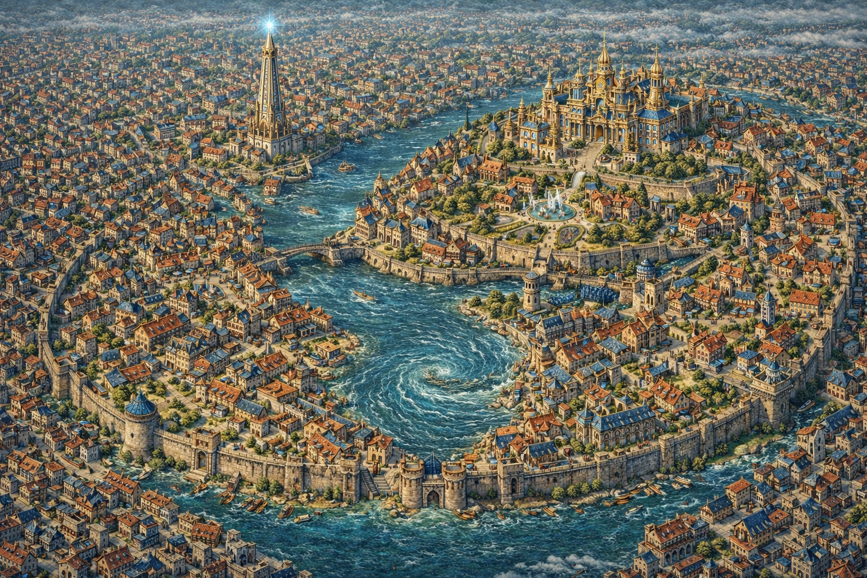
Olyad, the tall city
The Lighthouse
This functions as an actual lighthouse and the center of the grounds for the Regime’s military. All four branches are trained and headquartered here. You will be calling this towering spire home. Well… almost.
Royal Palace
Olyad is considered the center of civilization. The Royal Palace is the epicenter of the city. The epitome of excess and advanced technology, the Palace has been home to House Aurelias for six generations. It is considered the honor of a lifetime to step within the royal walls.

Slide 13
Olyad, the tall city
The Lighthouse
This functions as an actual lighthouse and the center of the grounds for the Regime’s military. All four branches are trained and headquartered here. You will be calling this towering spire home. Well… almost.
Royal Palace
Olyad is considered the center of civilization. The Royal Palace is the epicenter of the city. The epitome of excess and advanced technology, the Palace has been home to House Aurelias for six generations. It is considered the honor of a lifetime to step within the royal walls.

Slide 14
Olyad, the tall city
The Lighthouse
This functions as an actual lighthouse and the center of the grounds for the Regime’s military. All four branches are trained and headquartered here. You will be calling this towering spire home. Well… almost.
The Beacon
This functions as an actual lighthouse and the center of the grounds for the Regime’s military. All four branches are trained and headquartered here. You will be calling this towering spire home. Well… almost.
Royal Palace
Olyad is considered the center of civilization. The Royal Palace is the epicenter of the city. The epitome of excess and advanced technology, the Palace has been home to House Aurelias for six generations. It is considered the honor of a lifetime to step within the royal walls.

Slide 15
Olyad, the tall city
The Beacon
This functions as an actual lighthouse and the center of the grounds for the Regime’s military. All four branches are trained and headquartered here. You will be calling this towering spire home. Well… almost.
Royal Palace
Olyad is considered the center of civilization. The Royal Palace is the epicenter of the city. The epitome of excess and advanced technology, the Palace has been home to House Aurelias for six generations. It is considered the honor of a lifetime to step within the royal walls.

Slide 16
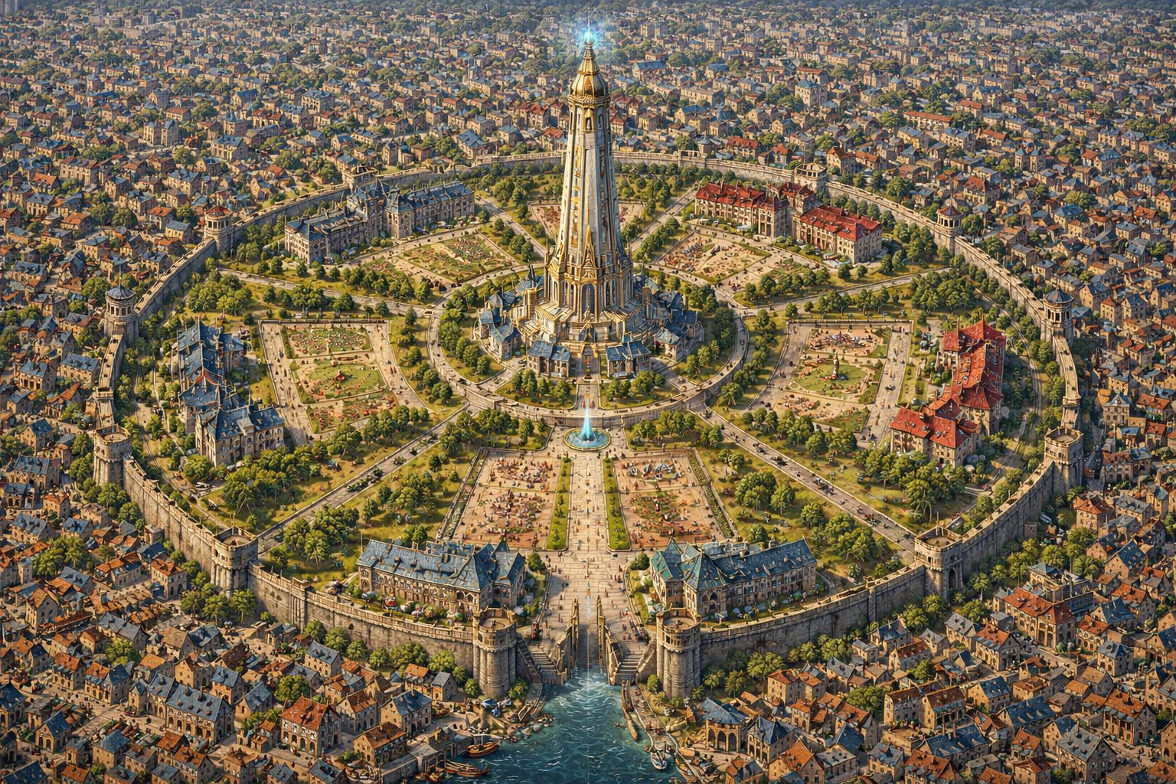
The Beacon
Royal Palace
Olyad is considered the center of civilization. The Royal Palace is the epicenter of the city. The epitome of excess and advanced technology, the Palace has been home to House Aurelias for six generations. It is considered the honor of a lifetime to step within the royal walls.
Royal Palace
Olyad is considered the center of civilization. The Royal Palace is the epicenter of the city. The epitome of excess and advanced technology, the Palace has been home to House Aurelias for six generations. It is considered the honor of a lifetime to step within the royal walls.
Scouts’ Barracks
The home of the lowly Scouts, this barracks is still substantially better in quality and armaments than the Training Grounds.
Training Grounds
This wonderful barracks and combat field is where you will call home. Only the bravest, strongest, and richest survive the trials and wind up moving into one of the three honored branches of military. The rest wind up in the Scouts.

Slide 17
The Regime Military

Slide 18


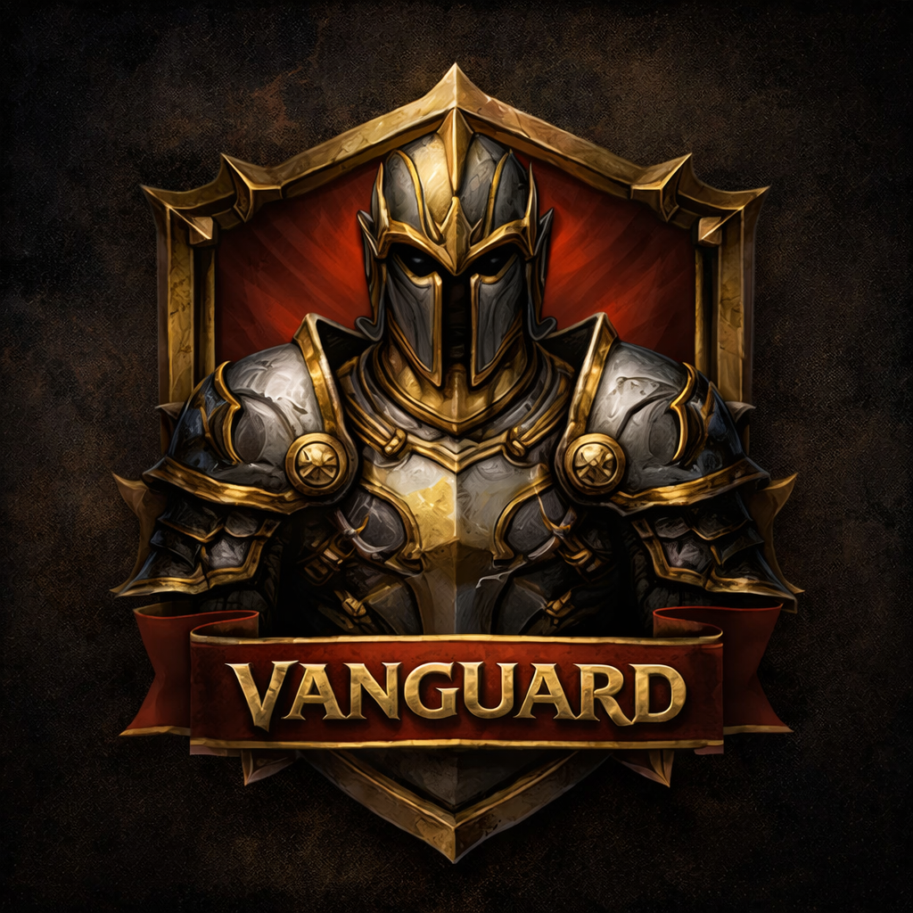
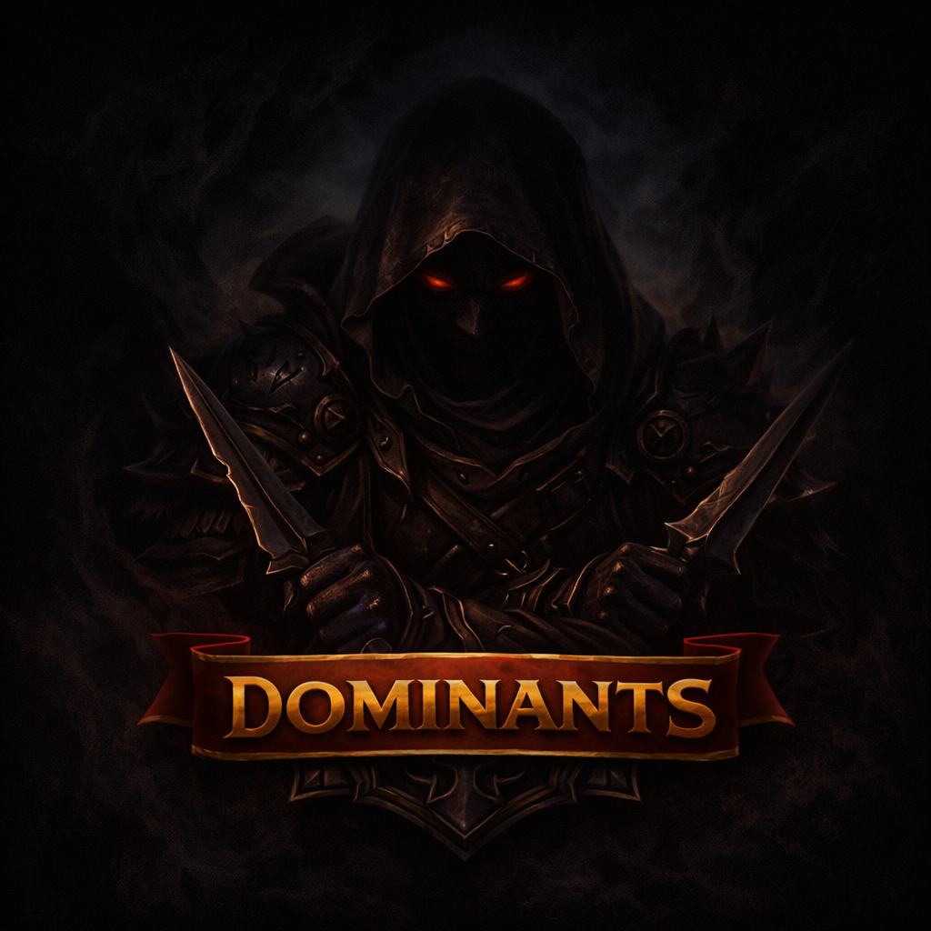
The Regime Military

Slide 19
The Regime Military
The Scouts
The scouts are viewed as part death sentence, part steppingstone to greatness. Any commoner or disgraced house member that has found their way into high society has traversed this path. Widely regarded as the dumping ground of the military, nearly all graduates wind up in the scouts.
The Scouts are the tip of the spear in Project Deliverance. The survival rate for scouts on their first mission is 30%. I hope you like those odds, because they don’t like you.
Leader: Capt. Chadwick G. P. Tee

Slide 20
The Regime Military
The Diplomats
Magic users and children of nobles most often wind up as diplomats. Their mission is simple: travel to any world that has been scouted and appears to be amicable to induction into the Regime.
For worlds with formidable militaries, the Diplomats will do what they can to broker a peaceful induction, or sabotage as much of the world leadership as possible before the Van is called in.
Leader: Gen. Valmorian (the Great)

Slide 21
The Regime Military
The Vanguard
Eden is filled with people who still bear the bloodlust instilled during the war of unification. Most of those people aspire to be part of the vanguard.
The Van is sent in when a world is discovered to be hostile. If the Scouts are the dumping ground, the Vanguard are the clean-up crew.
if (when) you are killed on your mission, rest well knowing these crazy bastards will be sent through 72 hours after your arrival to raze the world that became your grave. You won’t be lonely in death.
Leader: Maj. B. rick Shithouse

Slide 22
The Regime Military
The Dominants
Children on other worlds check under their beds at night for monsters. It’s the Dominants.
Adults are afraid to walk down dark alleys because of what might lurk there. It’s the Dominants.
Rangers know when the forest goes quiet, danger is near. It’s the dominants.
Part Boogeyman. Part Seal Team Six. These special forces are sent in when a scalpel is needed rather than a hammer. They despise all other branches and exalt in their least oft performed duty: Defector Tracking.
Leader: Undisclosed

Slide 23
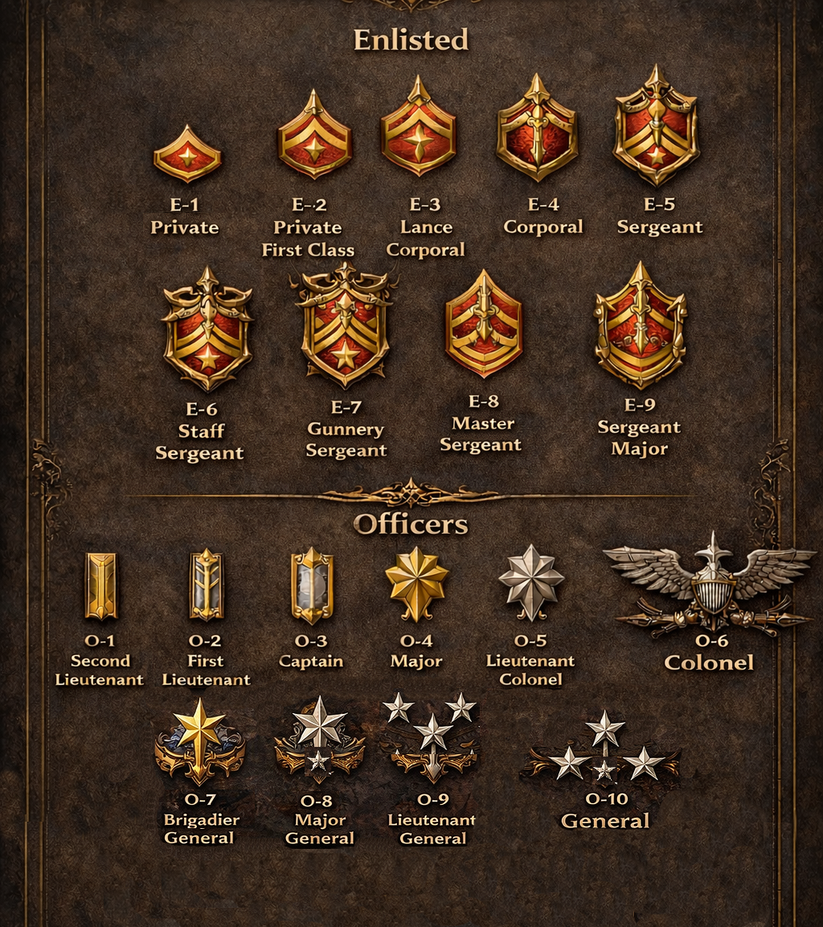
The Regime Military
Hierarchy
Regardless of your branch, the military follows the same rank structure.
The structure is broken down into two parts: Enlisted and Officers.
At first, a higher rank means better accommodations, gear, and mission rewards. after a few promotions, a higher rank means a better life.

Slide 24
The Beacon
Vanguard Barracks
The most dangerous of all the Barracks. Fights break out at breakfast. Healing is needed by lunch. Bodies are burned by dinner. Putting this many hotheads into confined spaces yields scary results, but it keeps them sharp.
Diplomats Barracks
While this building originally functioned as the home of the Diplomats, since Valmorian’s ascension to General, the Diplomat’s make The Beacon itself their home. The overflow and newly promoted Diplomats call the old Barracks home.
Dominants Barracks
What is known about this barracks is that it belongs to the Dominants. No one outside of this branch of military is allowed to step foot inside. Trainees are often dared to gain entry. The dumb ones actually try.
Scouts Barracks
The home of the lowly Scouts, this barracks is still substantially better in quality and armaments than the Training Grounds.
Training Grounds
These wonderful twin barracks and combat fields are your current home. Only the bravest, strongest, and richest survive the trials and wind up moving into one of the three honored branches of military. The rest wind up in the Scouts.

Slide 25
The Beacon
The Beacon
The Royal Palace is the home of excess. This is the home of innovation. The Beacon itself holds all military research and technological advancements including the greatest discovery in Eden’s long history: Gateways.
Vanguard Barracks
The most dangerous of all the Barracks. Fights break out at breakfast. Healing is needed by lunch. Bodies are burned by dinner. Putting this many hotheads into confined spaces yields scary results, but it keeps them sharp.
Diplomats Barracks
While this building originally functioned as the home of the Diplomats, since Valmorian’s ascension to General, the Diplomats make The Beacon itself their home. The overflow and newly promoted Diplomats call the old Barracks home.
Training Grounds
These wonderful twin barracks and combat fields are your current home. Only the bravest, strongest, and richest survive the trials and wind up moving into one of the three honored branches of military. The rest wind up in the Scouts.
Dominants Barracks
What is known about this barracks is that it belongs to the Dominants. No one outside of this branch of military is allowed to step foot inside. Trainees are often dared to gain entry. The dumb ones actually try.
Scouts Barracks
The home of the lowly Scouts, this barracks is still substantially better in quality and armaments than the Training Grounds.

Slide 26
The Beacon
The Beacon
The Royal Palace is the home of excess. This is the home of innovation. The Beacon itself holds all military research and technological advancements including the greatest discovery in Eden’s long history: Gateways.
Diplomats Barracks
While this building originally functioned as the home of the Diplomats. Since Valmorian’s ascension to General, the Diplomats have made The Beacon itself their home. The overflow and newly raised Diplomats call the old Barracks home.
Vanguard Barracks
The most dangerous of all the Barracks. Fights break out at breakfast. Healing is needed by lunch. Bodies are burned by dinner. Putting this many hotheads into confined spaces yields scary results, but it keeps them sharp.
Dominants Barracks
What is known about this barracks is that it belongs to the Dominants. No one outside of this branch of military is allowed to step foot inside. Trainees are often dared to gain entry. The dumb ones actually try.
Scouts Barracks
The home of the lowly Scouts, this barracks is still substantially better in quality and armaments than the Training Grounds.
Training Grounds
This wonderful twin barracks and combat fields are your current home. Only the bravest, strongest, and richest survive the trials and wind up moving into one of the three honored branches of military. The rest wind up in the Scouts.

Slide 27
The Beacon
Vanguard Barracks
The most dangerous of all the Barracks. Fights break out at breakfast. Healing is needed by lunch. Bodies are burned by dinner. Putting this many hotheads into confined spaces yields scary results, but it keeps them sharp.
Diplomats Barracks
While this building originally functioned as the home of the Diplomats, since Valmorian’s ascension to General, the Diplomat’s make The Beacon itself their home. The overflow and newly promoted Diplomats call the old Barracks home.
Dominants Barracks
What is known about this barracks is that it belongs to the Dominants. No one outside of this branch of military is allowed to step foot inside. Trainees are often dared to gain entry. The dumb ones actually try.
The Beacon
The Royal Palace is the home of excess. This is the home of innovation. The Beacon itself holds all military research and technological advancements including the greatest discovery in Eden’s long history: Gateways.
Scouts Barracks
The home of the lowly Scouts, this barracks is still substantially better in quality and armaments than the Training Grounds.
Training Grounds
This wonderful twin barracks and combat fields are your current home. Only the bravest, strongest, and richest survive the trials and wind up moving into one of the three honored branches of military. The rest wind up in the Scouts.

Slide 28
Would you like to know more?

Slide 31
BE NOT AFRAID

Slide 32
FOR DELIVERANCE IS AT HAND
BE NOT AFRAID

Slide 33
BE NOT AFRAID
FOR DELIVERANCE IS AT HAND

Slide 34
BE NOT AFRAID
FOR DELIVERANCE IS AT HAND

Slide 35
The One True God

Slide 36
The One True God
symbolized by the Golden Halo surrounding his all-seeing eye, the religion of Eden is the followers of the One True God.
Known as “the Devout,” all other worshippers were driven from the mainland in the conflict known as the Purification war.
Followers of any other gods have long since fled to Serpent’s Island… or learned to keep their worship quiet.
The Purification war’s effects are felt to this day as any rejection of the devout’s leadership is met with accusations of following the One True God’s enemy. A being of pure evil
…

Slide 38
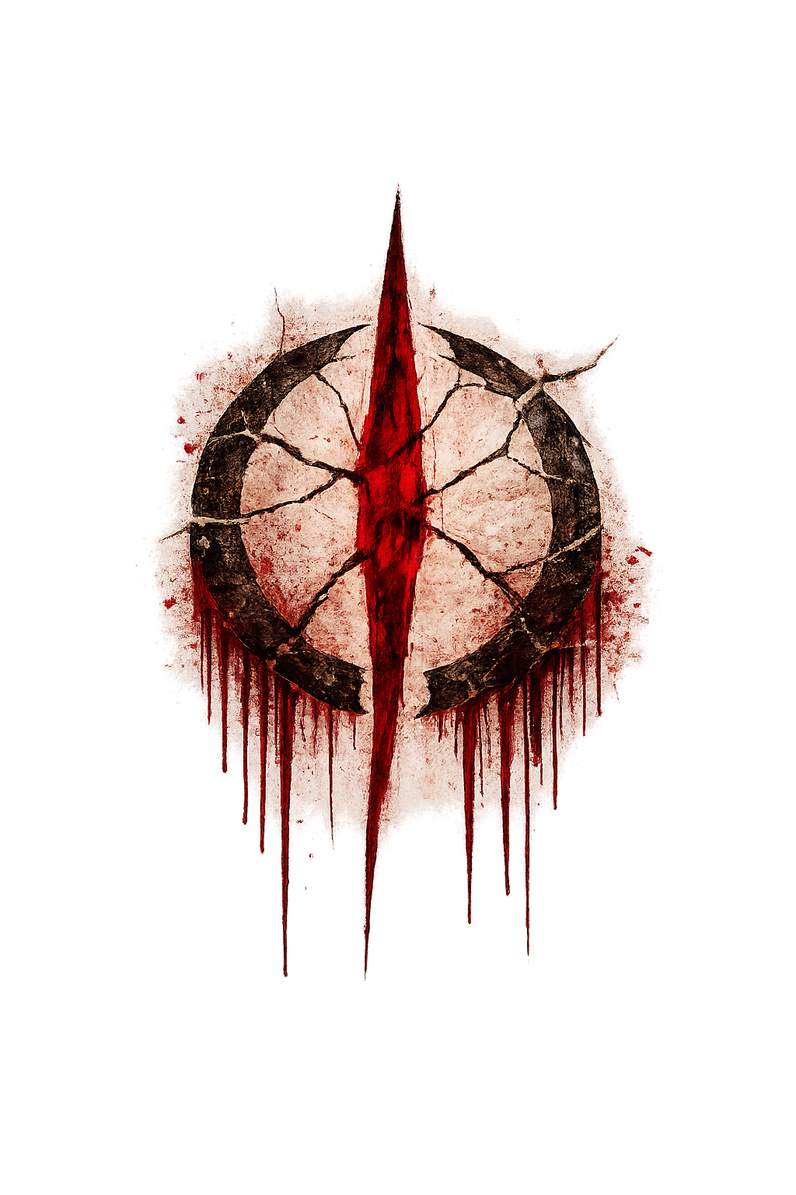
There are but two tenets of worship:

Slide 39
Money and Bitches
There are but two tenets of worship:

Slide 40
There are but two tenets of worship:
Money and Bitches

Slide 41
The Adversary
All that was once known about the adversary has long since been burned out on the mainland of Eden. The Adversary is everything the one true god is not.
Chaos. Destruction. Disobedience.
Actual worshippers of The Adversary are almost non-existent on the mainland. Accusations of his worship are typically used to destroy someone’s reputation or to force them into line.

Slide 42
The Adversary
All that was once known about the adversary has long since been burned out on the mainland of Eden. The Adversary is everything the one true god is not.
Chaos. Destruction. Disobedience.
Actual worshippers of The Adversary are almost non-existent on the mainland. Accusations of his worship are typically used to destroy someone’s reputation or to force them into line.
The Adversary still holds a foothold in this world on Serpent’s Island. Feel free to visit if you would like to be murdered on sight.

Slide 43
The Adversary
The Adversary still holds a foothold in this world on Serpent’s Island. Feel free to visit if you would like to be murdered on sight.

Slide 44
The Adversary still holds a foothold in this world on Serpent’s Island. Feel free to visit if you would like to be murdered on sight.

Slide 45
The Adversary still holds a foothold in this world on Serpent’s Island. Feel free to visit if you would like to be murdered on sight.

Slide 46
The Adversary still holds a foothold in this world on Serpent’s Island. Feel free to visit if you would like to be murdered on sight.

Slide 47
Recalibrating
.
.
.

Slide 48
Recalibrated.
Resuming onboarding.

Slide 49
Would you like to know more?

Slide 50
Project: Deliverance

Slide 51
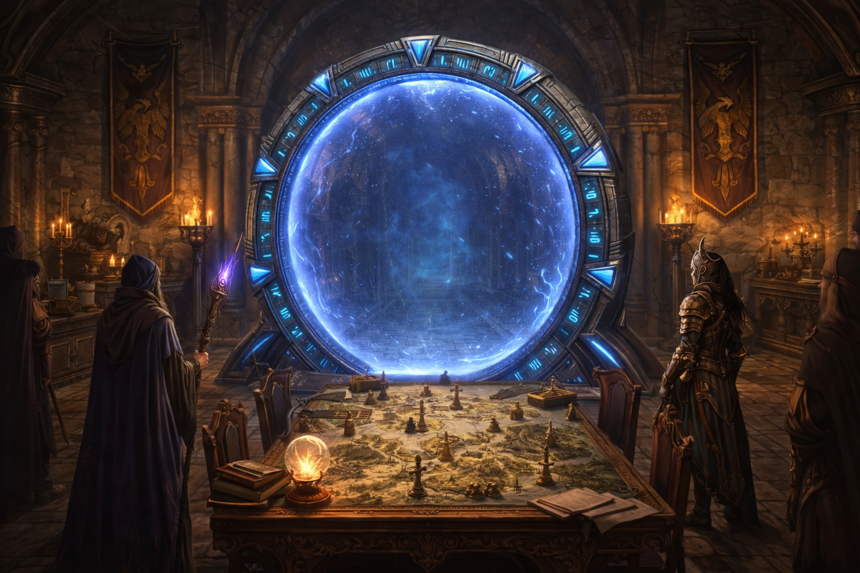
Project: Deliverance
This is why you are here. The most important initiative in Eden’s history began roughly 10 years ago. The beacon’s advancements in magic and technology has allowed The Regime to reach out and touch other worlds.
The original tenet of the unification war was simple: Deliverance through unity. You are here to go through the portals to these new worlds. Scout for resistance and Prepare any civilizations for Induction.
There is no need to negotiate or threaten. The Diplomats and the Vanguard will handle that. Find out their needs and weaknesses.

Slide 52
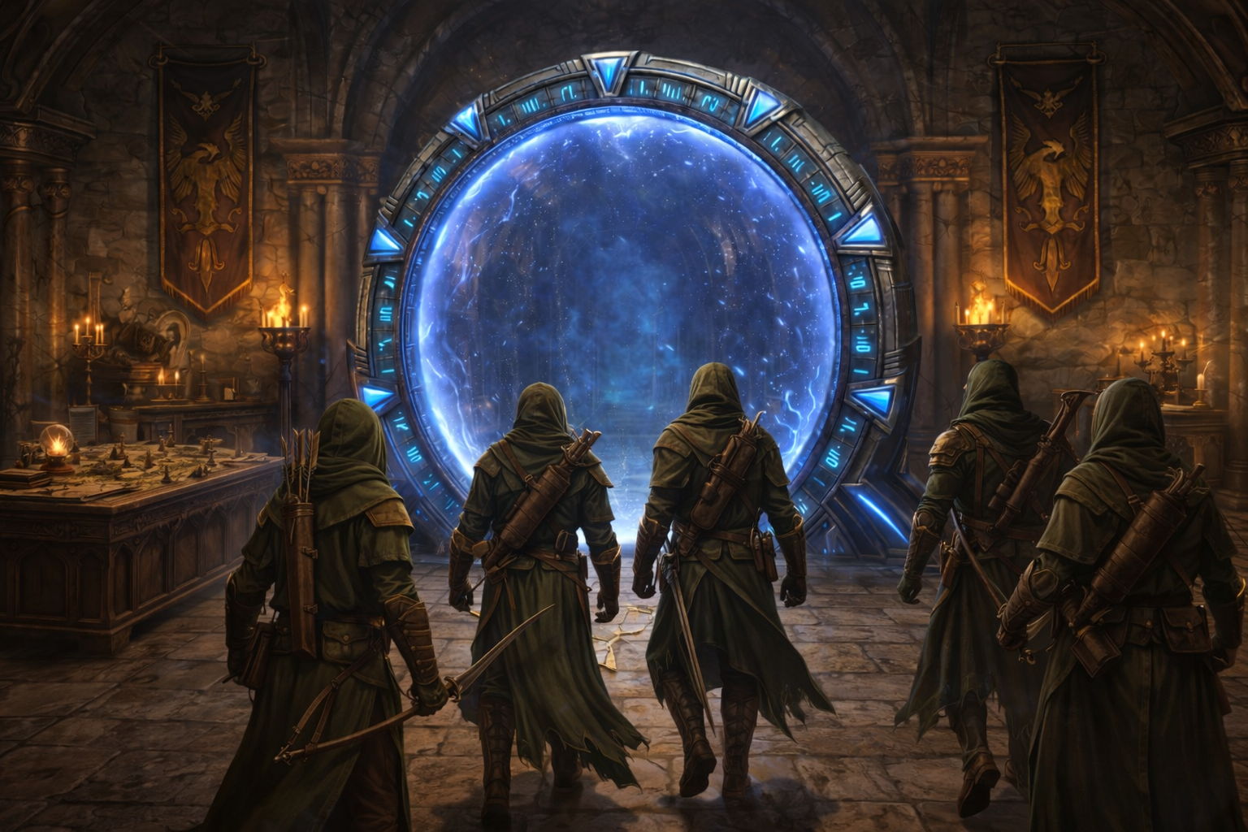
Project: Deliverance
This is why you are here. The most important initiative in Eden’s history began roughly 10 years ago. The beacon’s advancements in magic and technology has allowed The Regime to reach out and touch other worlds.
The original tenet of the unification war was simple: Deliverance through unity. You are here to go through the portals to these new worlds. Scout for resistance and Prepare any civilizations for Induction.
There is no need to negotiate or threaten. The Diplomats and the Vanguard will handle that. Find out their needs and weaknesses.

Slide 53
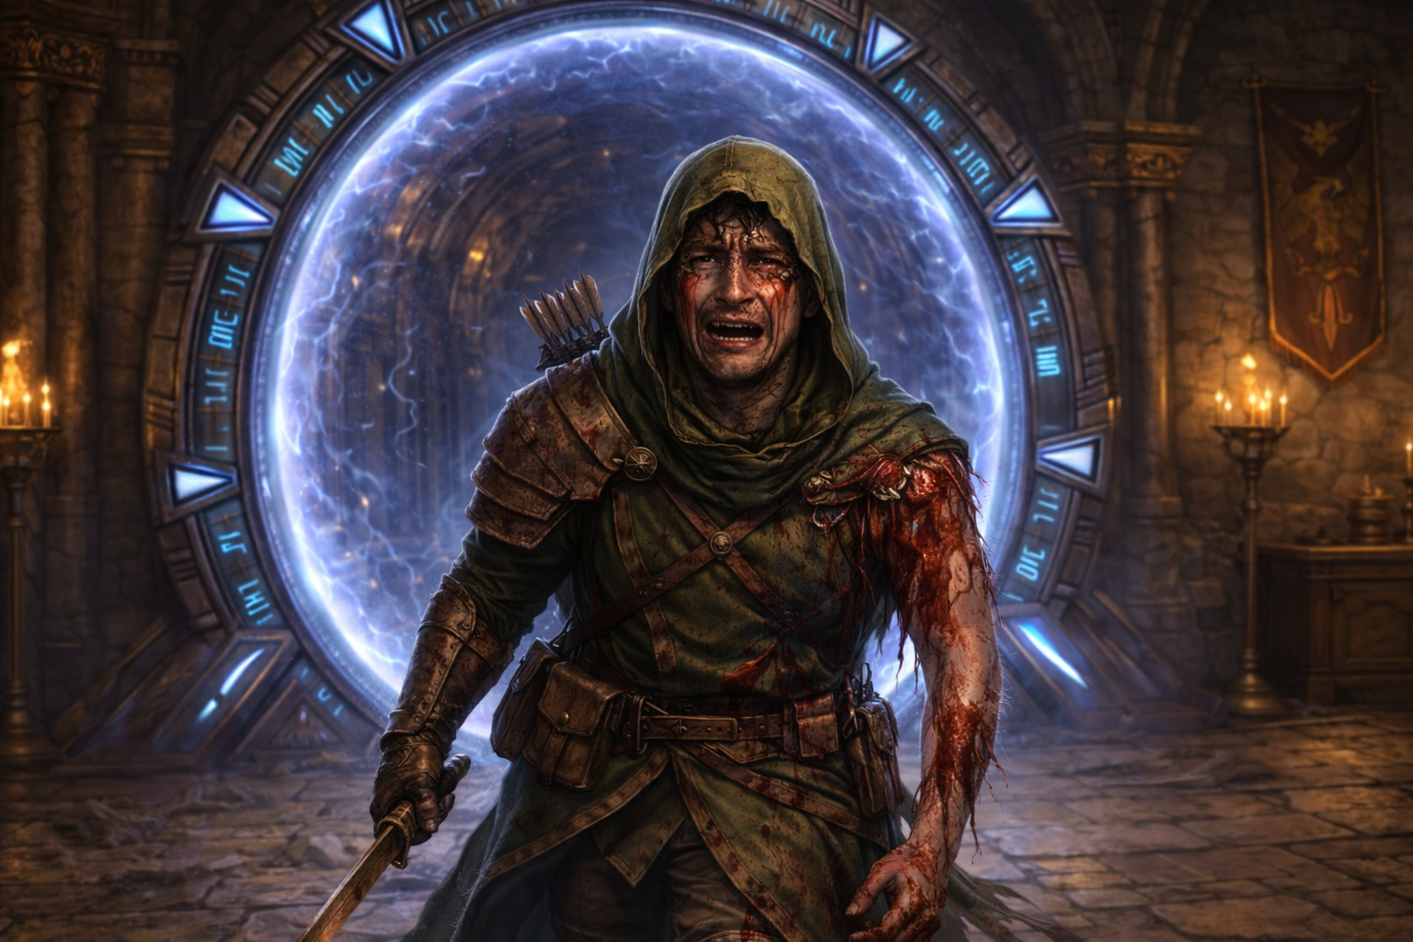
Project: Deliverance
This is why you are here. The most important initiative in Eden’s history began roughly 10 years ago. The beacon’s advancements in magic and technology has allowed The Regime to reach out and touch other worlds.
The original tenet of the unification war was simple: Deliverance through unity. You are here to go through the portals to these new worlds. Scout for resistance and Prepare any civilizations for Induction.
There is no need to negotiate or threaten. The Diplomats and the Vanguard will handle that. Find out their needs and weaknesses.

Slide 54
Welcome to Eden

Slide 55
The Five Great houses

Slide 56
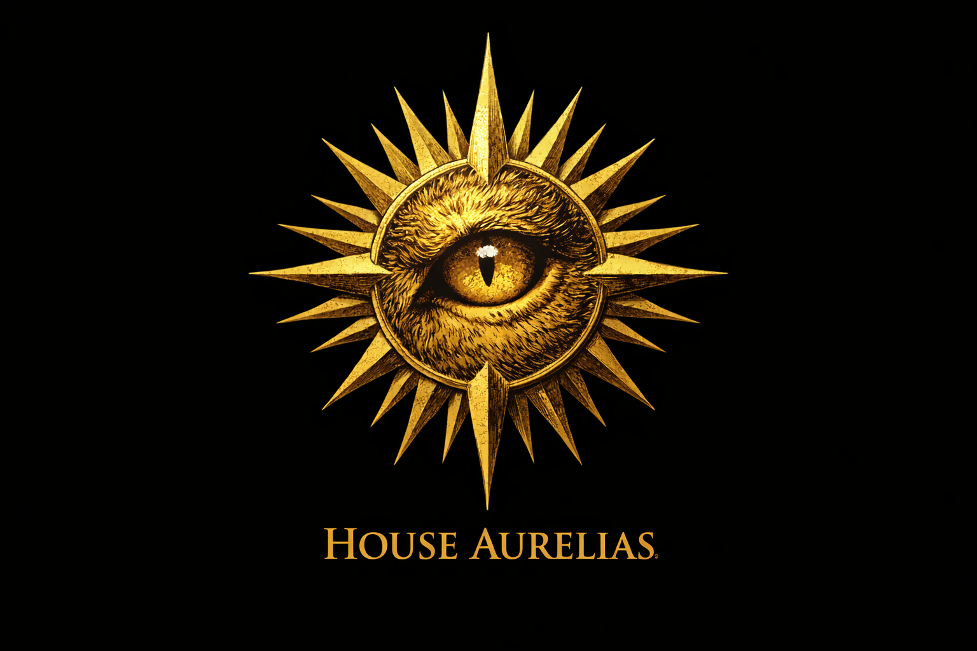
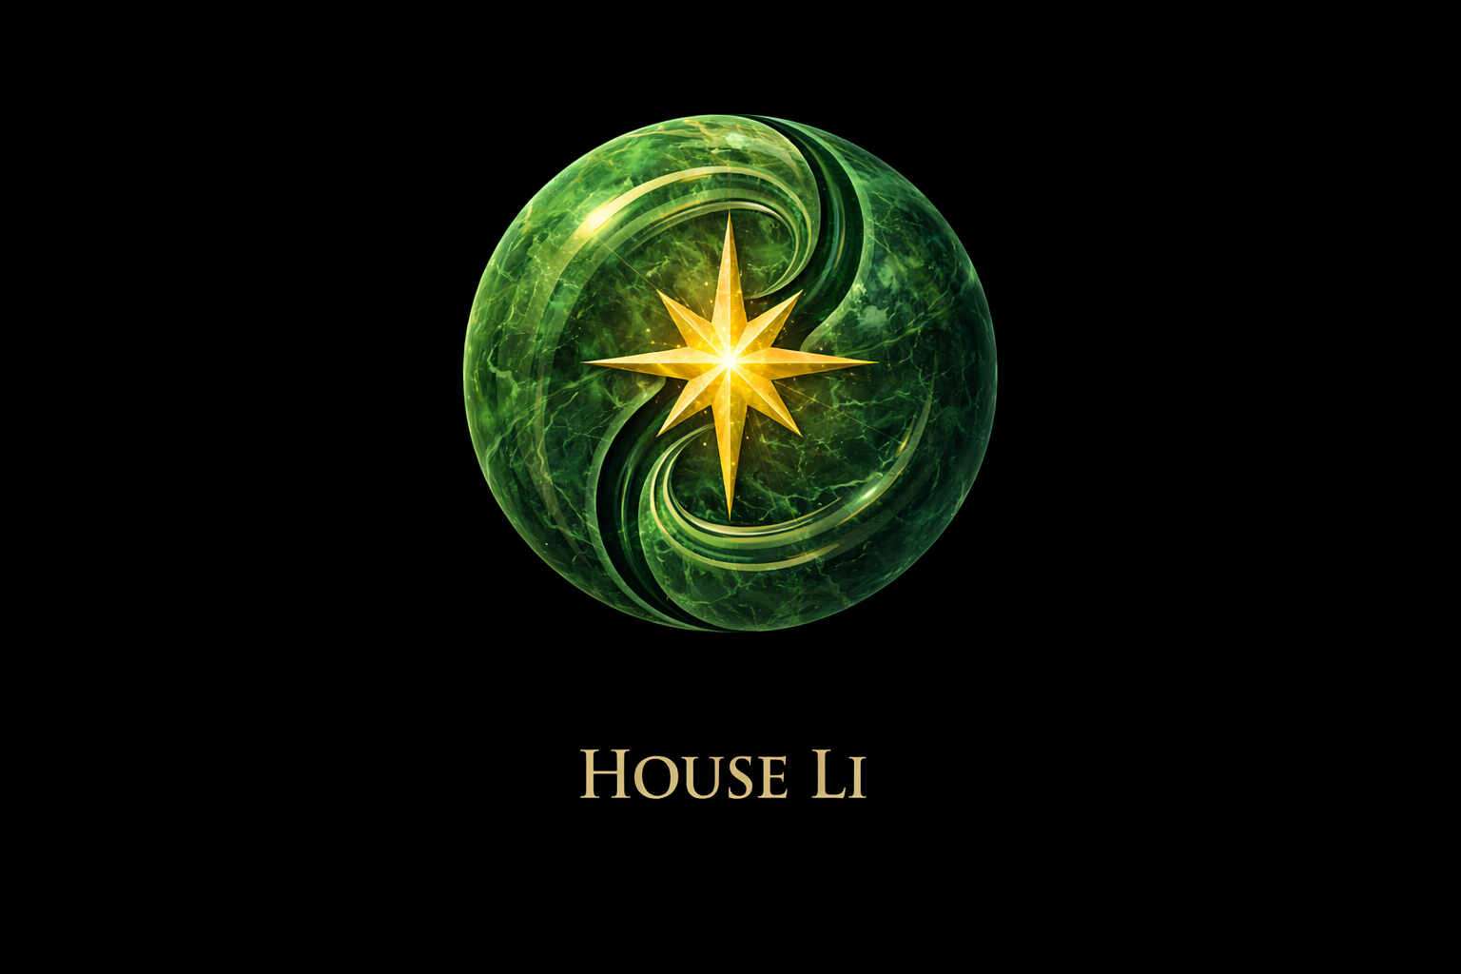

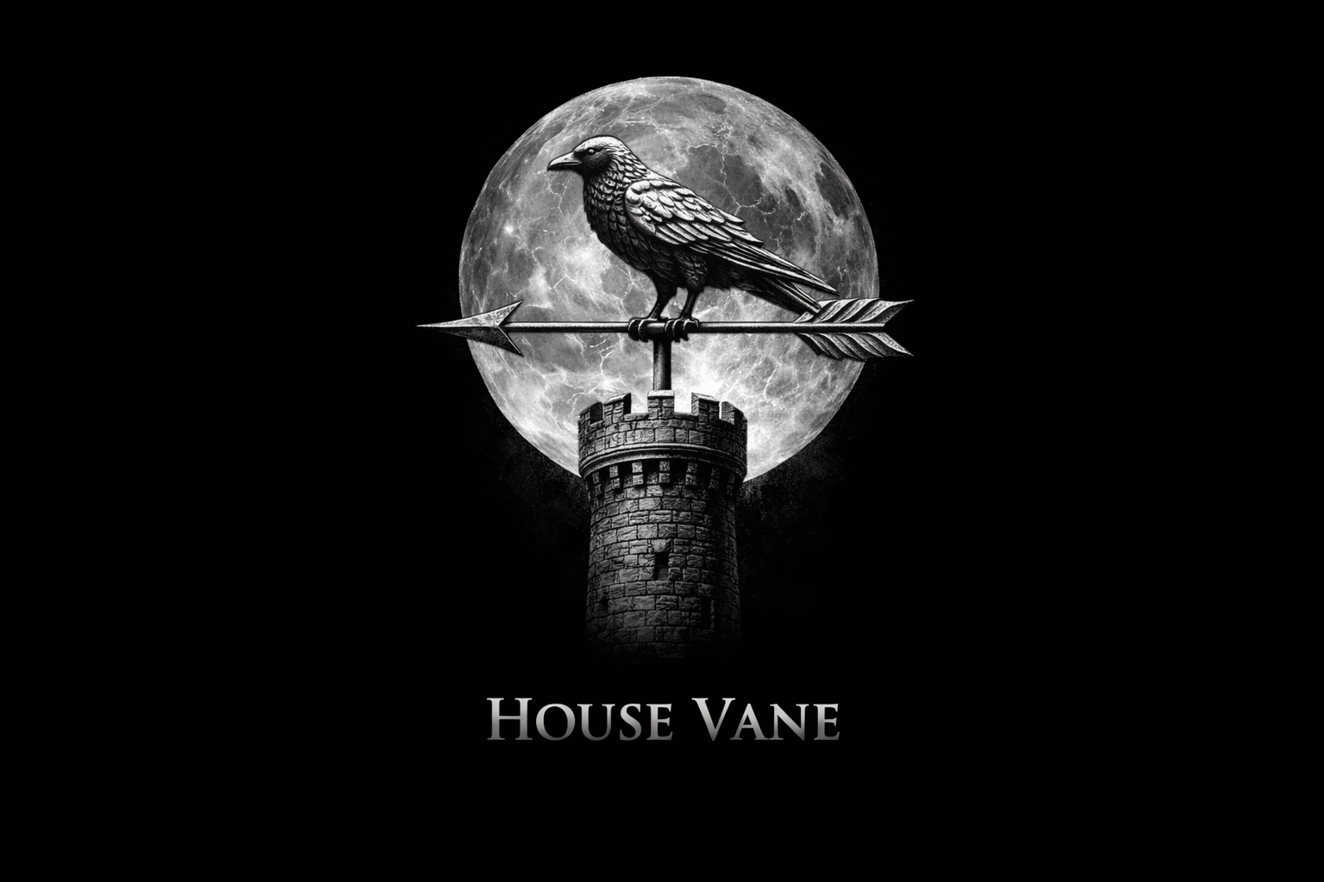
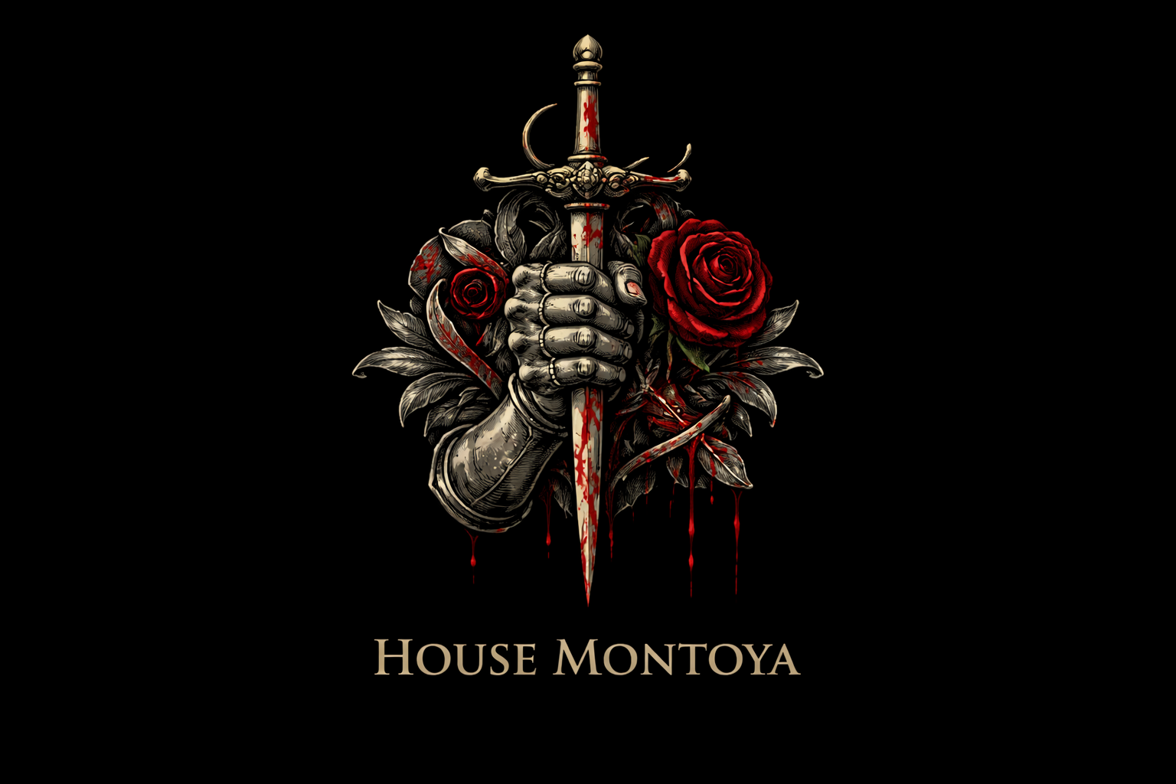
The Five Great houses

Slide 57
Welcome to Eden
Congratulations!
Your onboarding is complete

Slide 58
Welcome to Eden
Should you need any additional assistance or if you need to review this information, please visit our Regime intranet at: https://www.dndpod.com/
Congratulations!
Your onboarding is complete

